Slide 1
ONLINE EXAMINATION SYSTEM

Slide 2
ABSTRACT
The Online Examination System is an electronic application. This framework will help the college/Institution to assess the inquiry have different alternative with one right reply. The college/Institution can direct the online examination and report the outcome in a couple time.
The examination office is in charge of the creating the inquiry paper and it would be totally secure. Online Examination framework give remotely access to understudies. It assists the inspector with reducing the work of leading exam, checking answer sheets and producing result. All this work is finished by the machine.
All the information is put away on the server. What’s more, customers can get to these databases and give exam. There are two sorts of exam segment Practice and Real test. Understudies can give both tests. Right answer will be highlighted in diverse shading. Subsequent to submitting test the outcome will be created and examinations is done on the premise of result and send it to every single understudy

Slide 3
HARDWARE SPECFICATION
Processor : P 4 700 GHz.
RAM : 4 GB RAM
Hard Disk Drive : 180 GB

Slide 4
SOFTWARE SPECIFICATION
Operating System : Windows 7/8/10
Front End : PHP
Back End : ORACLE

Slide 5
EXISTING SYSTEM
The whole process of assigning test and evaluating their scores after the test, was done manually till date. Processing the test paper i.e. checking and distributing respective scores used to take time when the software was not installed
DISADVANTAGES
The current system is very time consuming.
To take exam of more candidates more invigilators are required but no need of
invigilator in case of online examination.
The chances of paper leakage are more in current system as compared to proposed
system.
Result processing takes more time as it is done manually.

Slide 6
PROPOSED SYSTEM
The online test created for taking online test has following features. In comparison to the present system the proposed system will be less time consuming and is more efficient. Result will be very precise and accurate and will be declared in very short
ADVANTAGES
span of time because calculation and evaluations are done by the simulator
itself.
The proposed system is very secure as no chances of leakage of question
paper as it is dependent on the administrator only.
The logs of appeared candidates and their marks are stored and can be
backup for future use

Slide 7
Modules
Student Registration
This module collects the information about the student, which collect name, roll number, register number and class details. It may depend on the school or college once student has registered can able to attend the test.
Add questions & answers
Admin or teachers create the question and answer to the question registration screen and update the answer first. Then the system validates the question and answers and provide the results.

Slide 8
Admin & student login
Here admin login is act as a register and questions sheet, and student login will be used to attend the test
Take Exam
Once the student after login can attend the exam, here there’s a limitation time to attend the exam, which has strictly followed by the admin.
Exam result
The exam result can be generated with in a second, background it’s validated the question and suitable answers, here the minus marks also we are focusing to implement.

Slide 9

Data Flow Diagram
Level 0

Slide 10
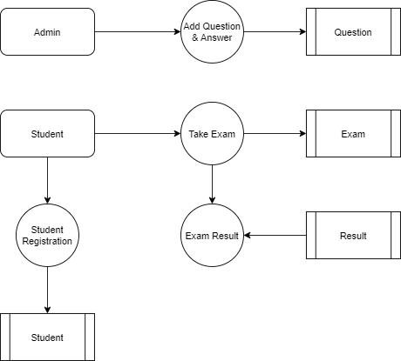
Level 1:

Slide 11
Thank You

